Slide 1

CSE 350 Digital Electronics and Pulse Techniques
Comparator and Schmitt Trigger
Course Instructor: Shomen Kundu (SDU)
Mail: shomen.kundu@bracu.ac.bd
Desk: 4N148

Slide 2
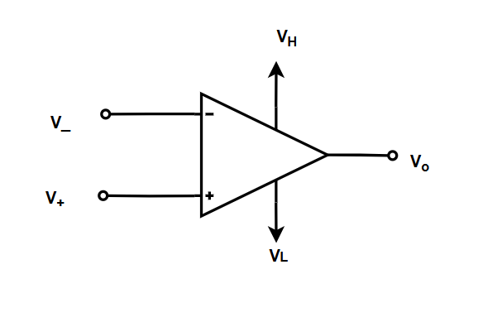
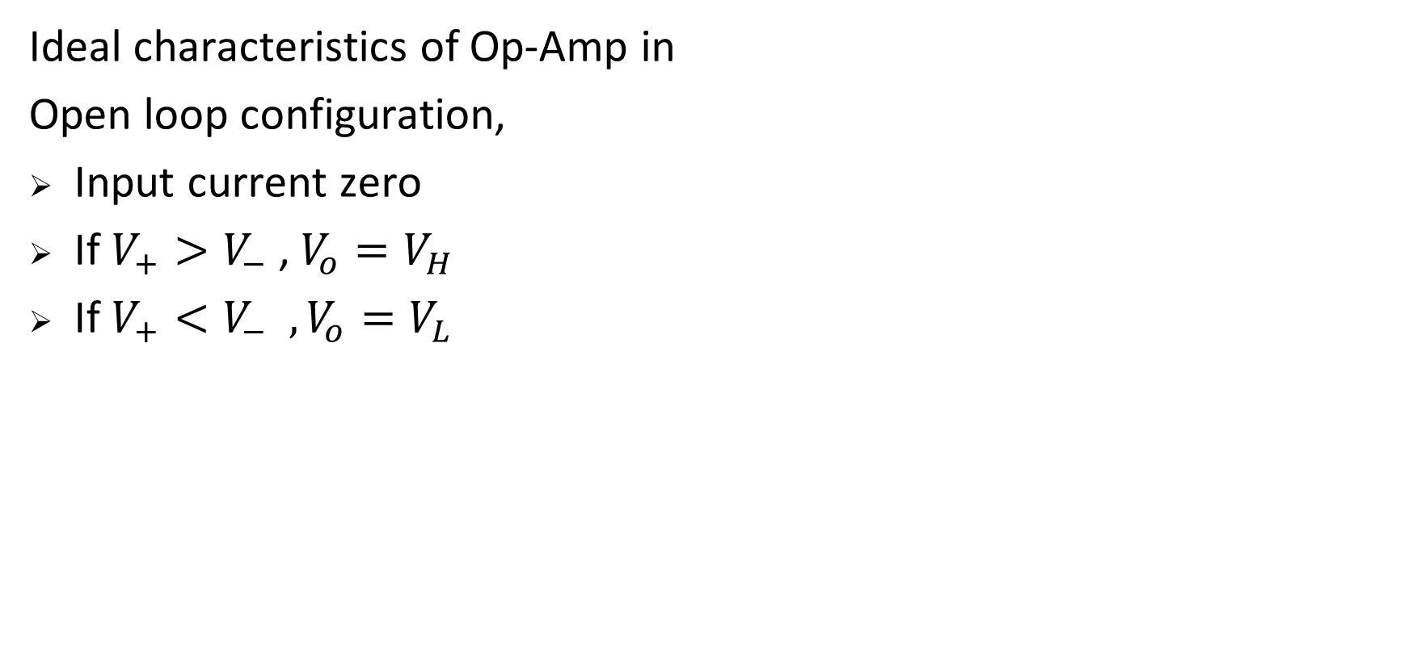
Op-Amp

Slide 3
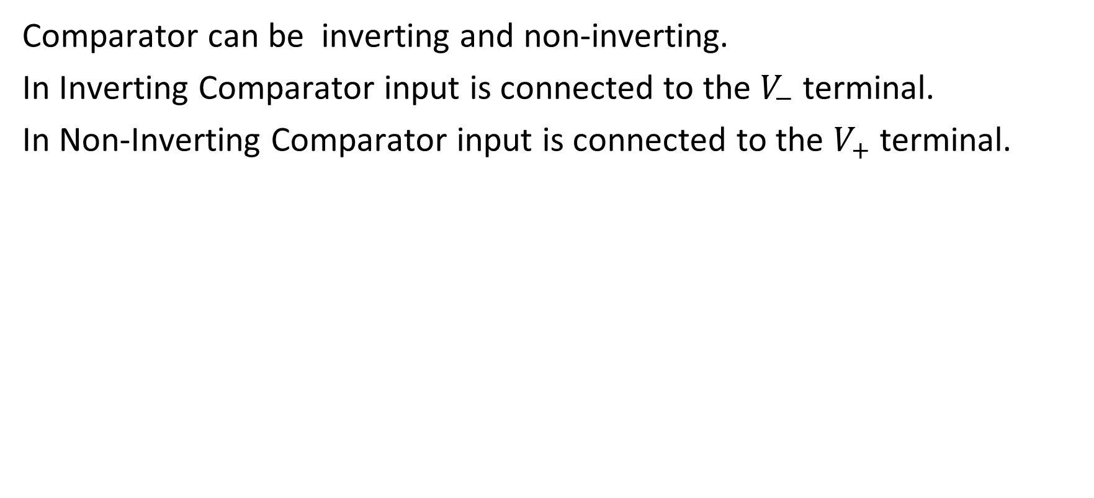
Op-Amp Comparator

Slide 4
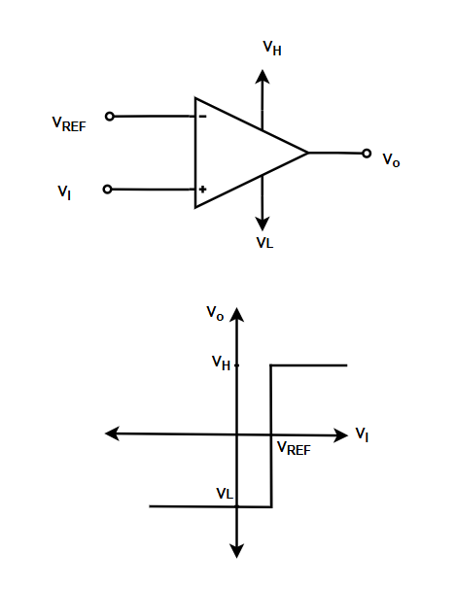
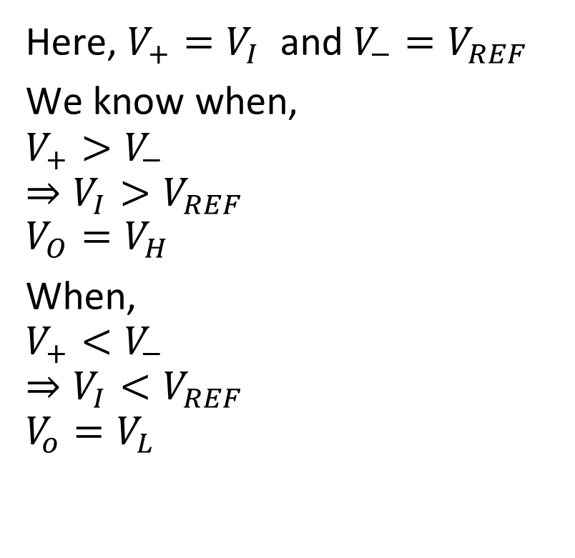
Non-Inverting Comparator

Slide 5
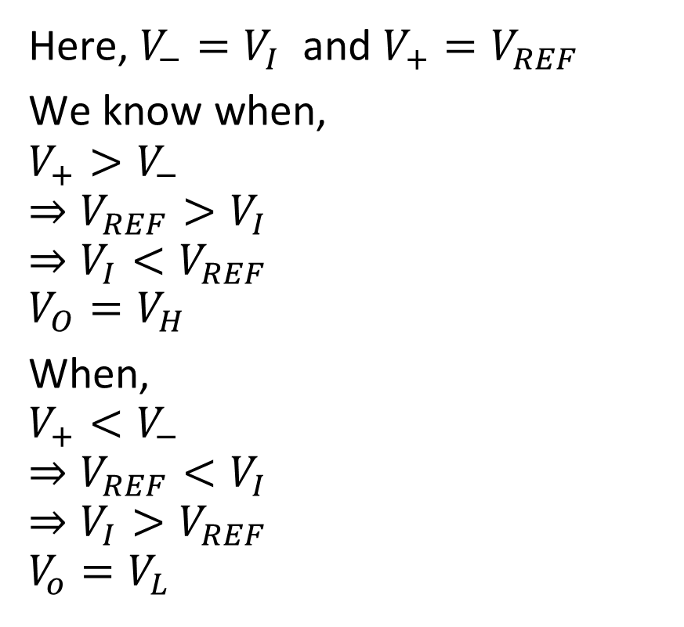
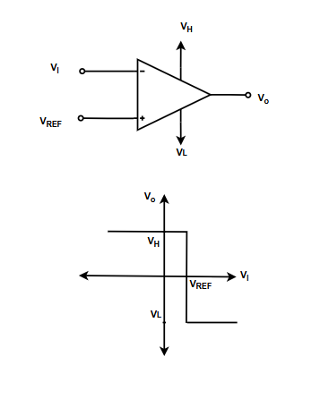
Inverting Comparator

Slide 6
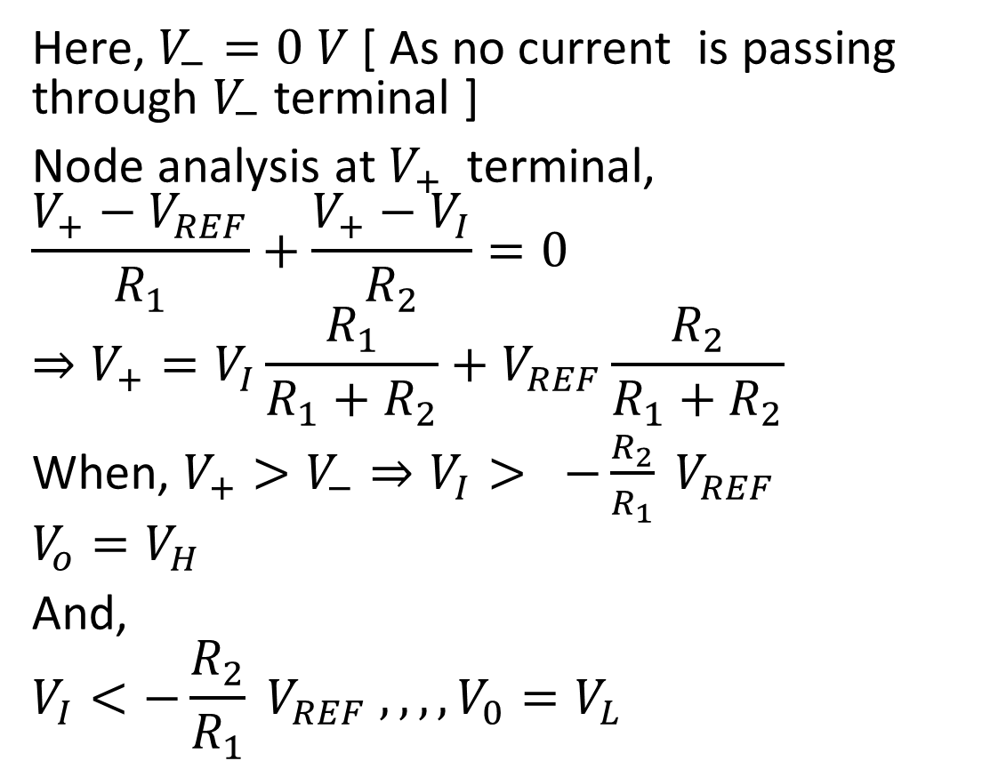
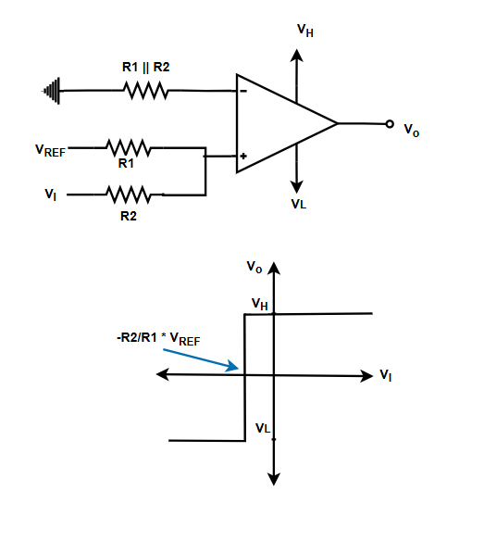
Non-Inverting Comparator with Divider

Slide 7
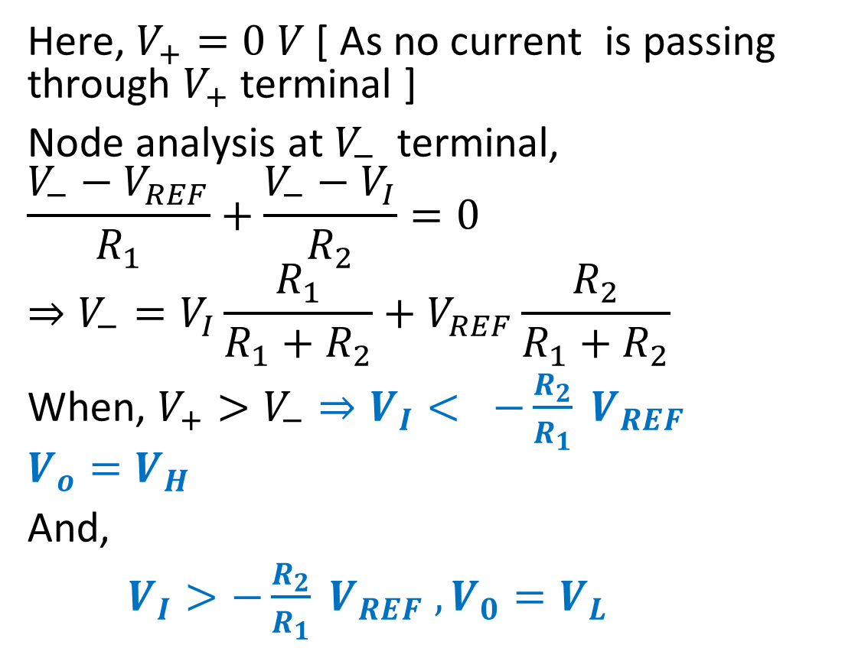
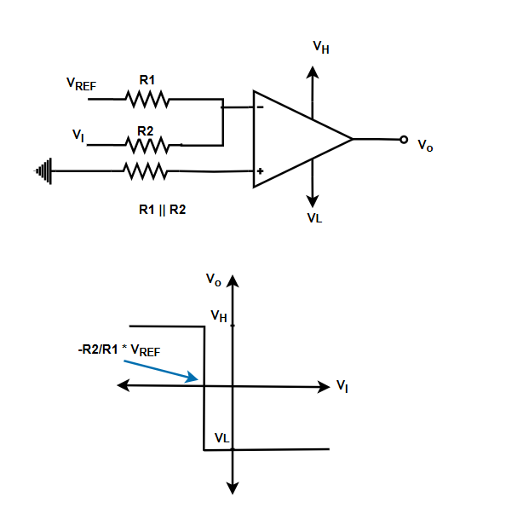
Inverting Comparator with Divider

Slide 8
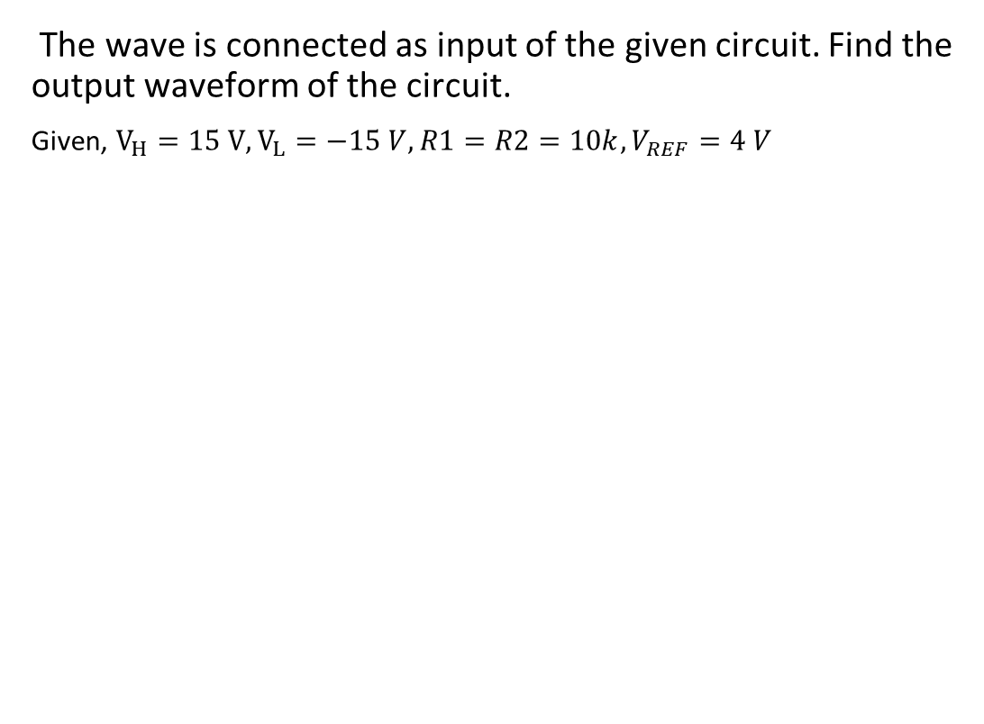
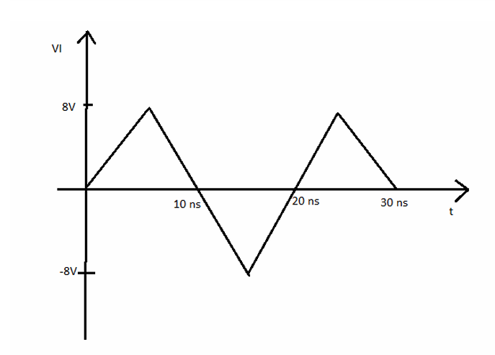
Exercise

Slide 9
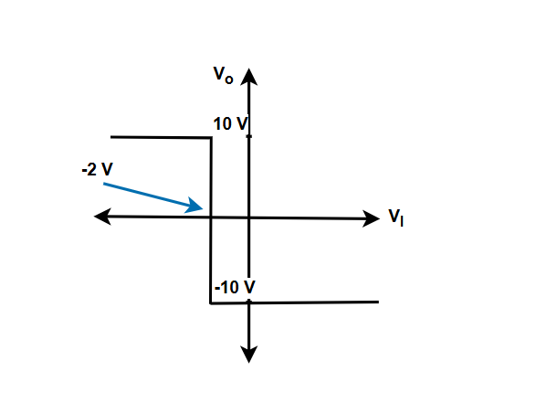
Exercise
Design a comparator circuit that will show the given transfer curve. You need to use 5 V as reference voltage.

Slide 10
Exercise
Design a comparator for street light control system. The photodetector detect light intensity and outputs a corresponding voltage. The detector output is 0 V when intensity of light is 0% of Max intensity and 5 V when the intensity of light Maximum. Design the comparator such that it can turn on the street light when the intensity is below 15% of the Max Light intensity.
You must satisfy all the mentioned criteria, and assume any component values accordingly.

Slide 11
Schmitt Trigger circuit
We will study 4 types of Schmitt Trigger circuit
Inverting ST
Non-inverting ST
Inverting ST with Ref
Non-inverting with Ref

Slide 12
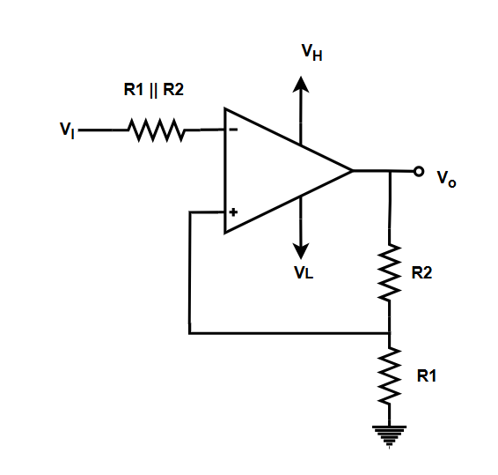
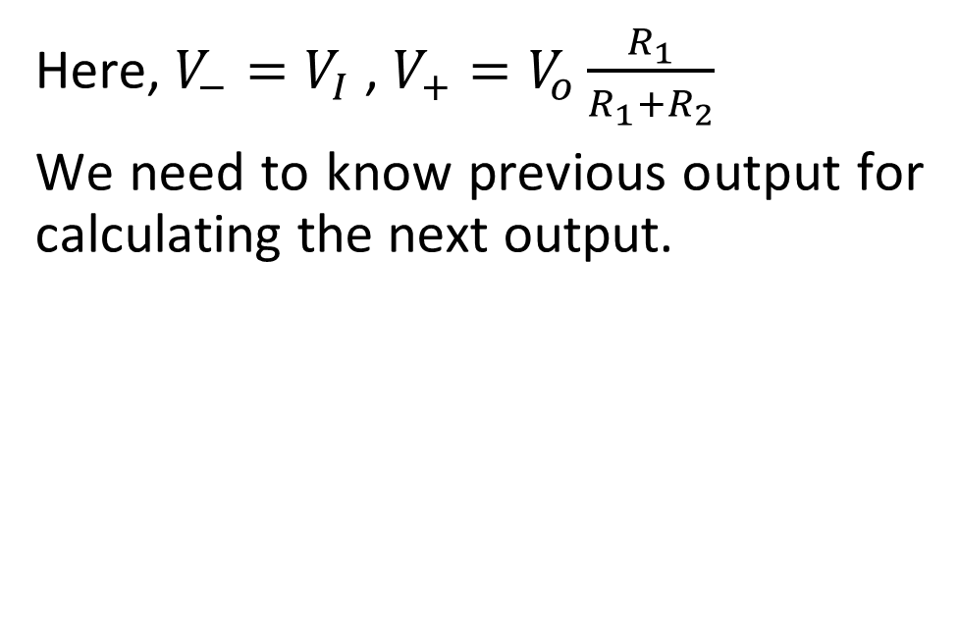
Inverting ST

Slide 13
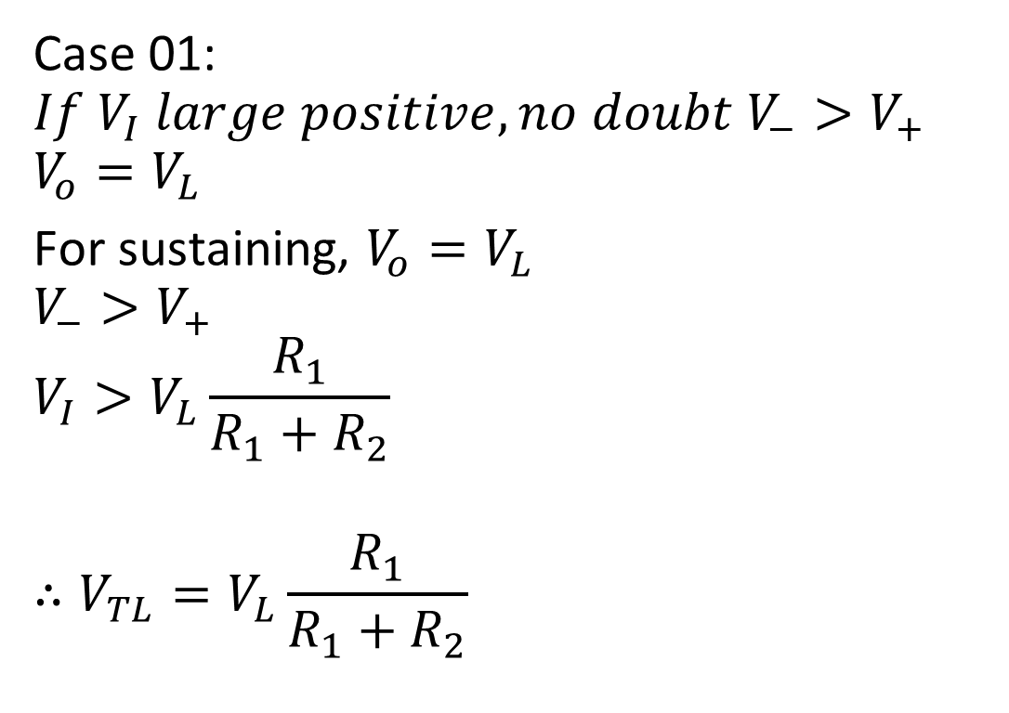
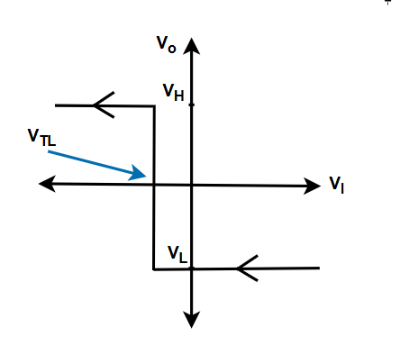
Inverting ST

Slide 14
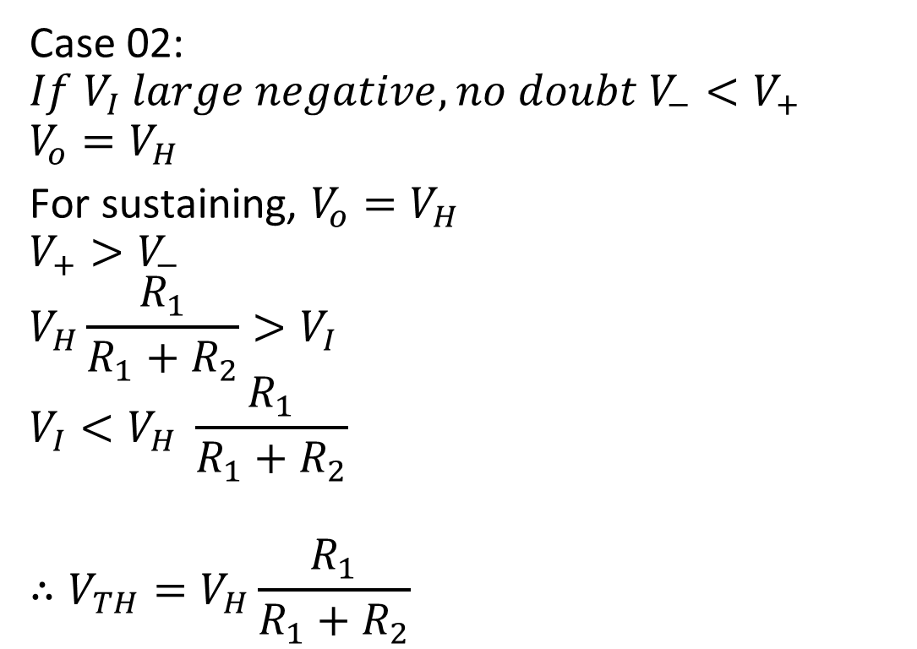
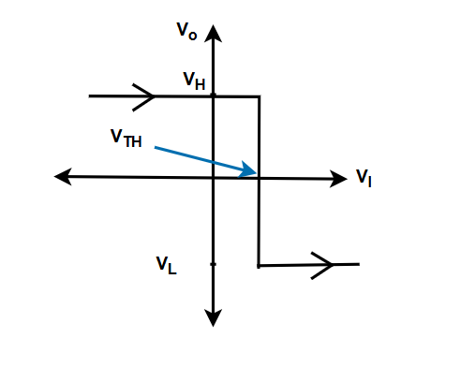
Inverting ST

Slide 15
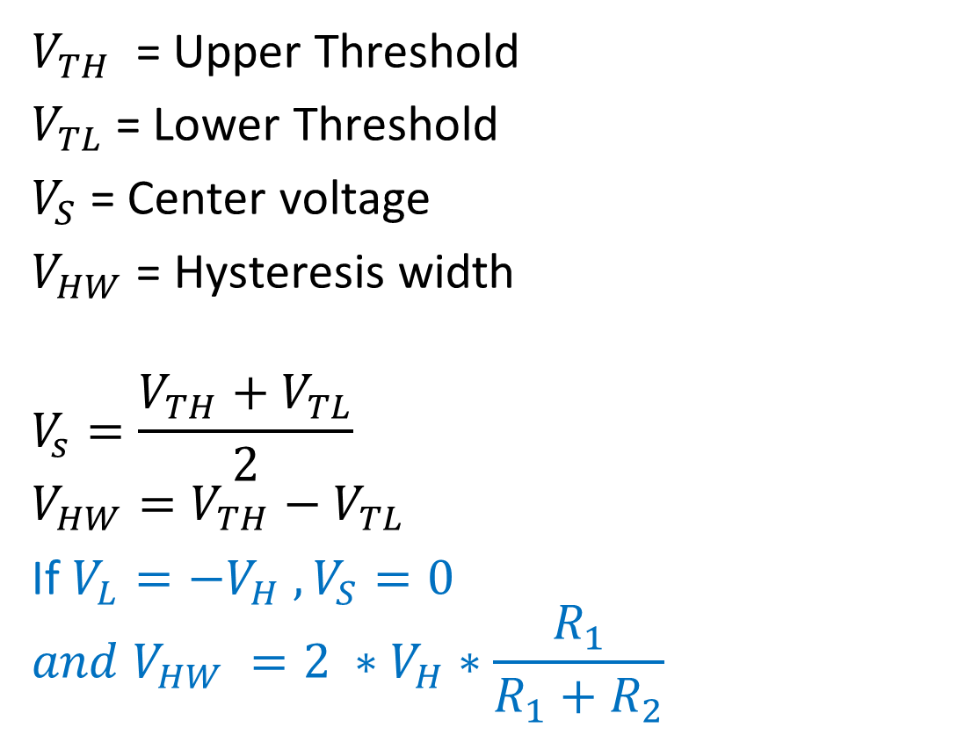
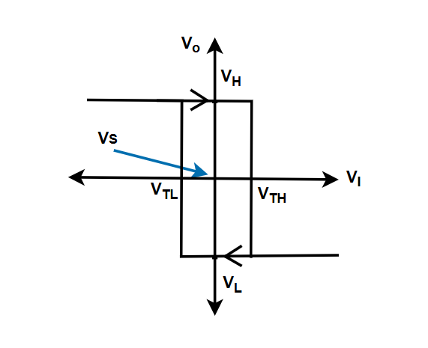
Inverting ST

Slide 16
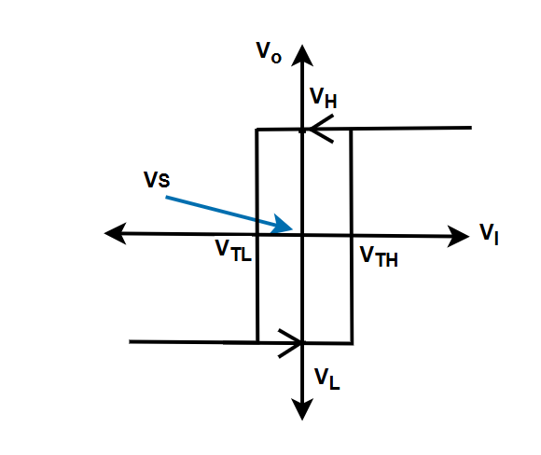
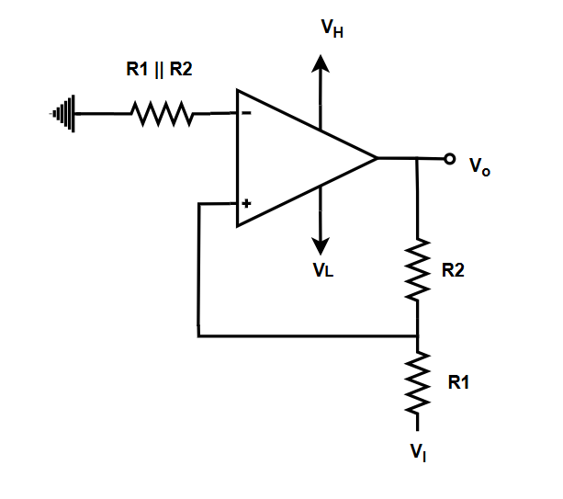
Non-inverting ST
Type here

Slide 17
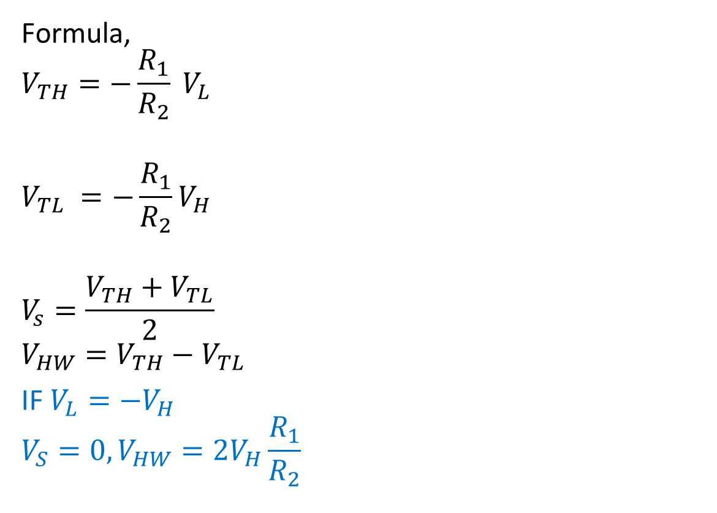
Non-inverting ST

Slide 18
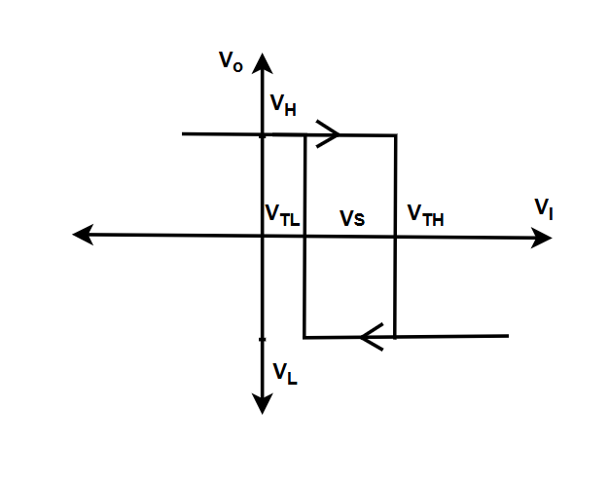
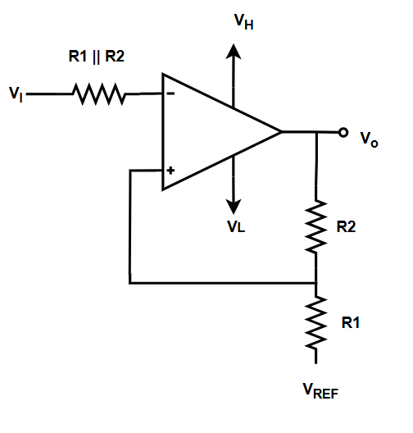
Inverting ST with Ref
Type here

Slide 19
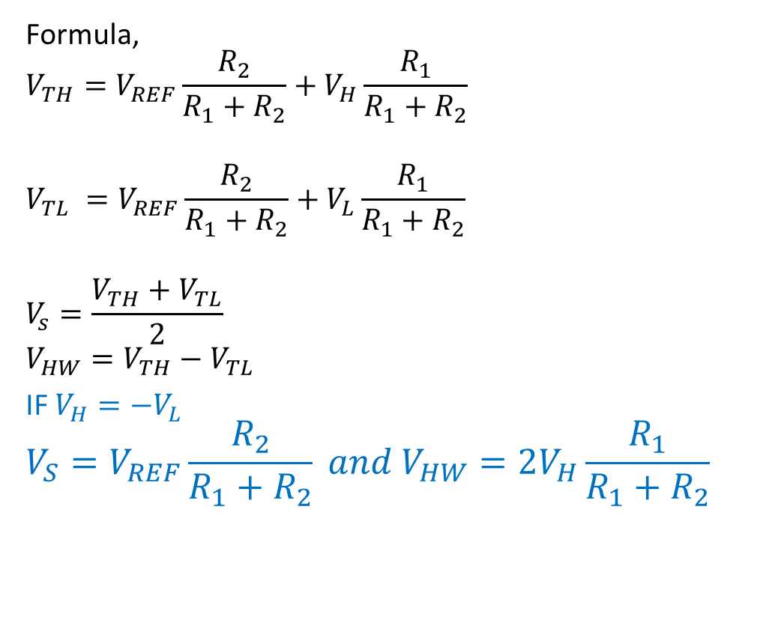
Inverting ST with Ref

Slide 20
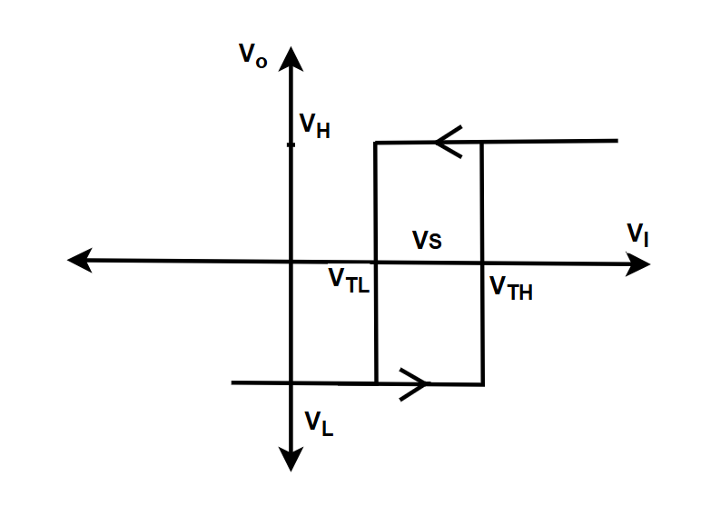
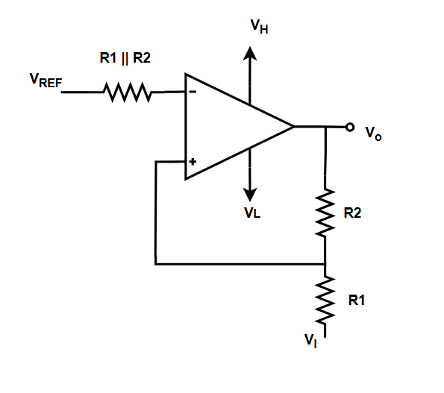
Non-inverting ST with Ref
Type here

Slide 21
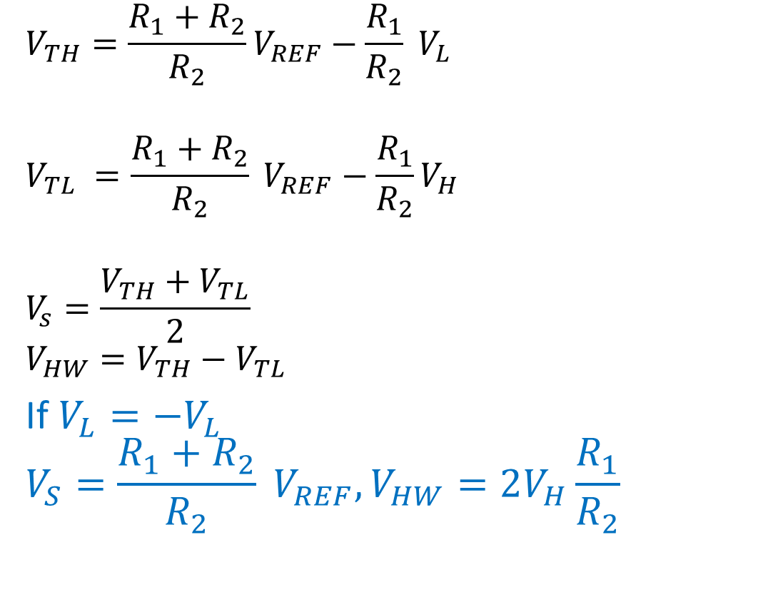
Non-inverting ST with ref

Slide 22
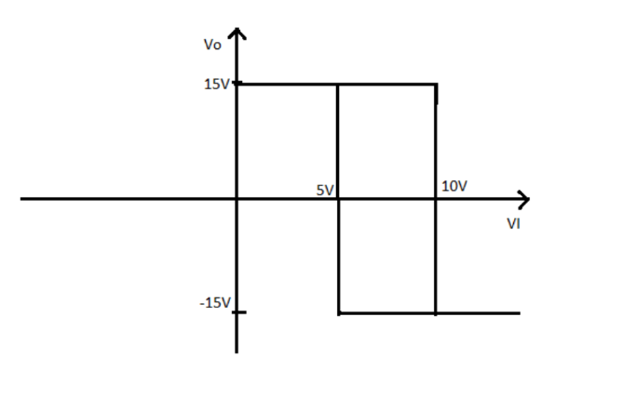
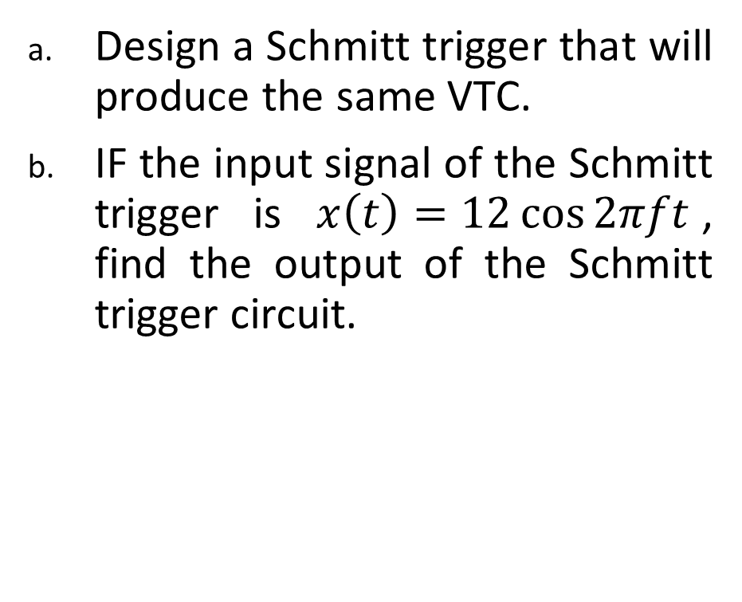
Exercise:

Slide 23
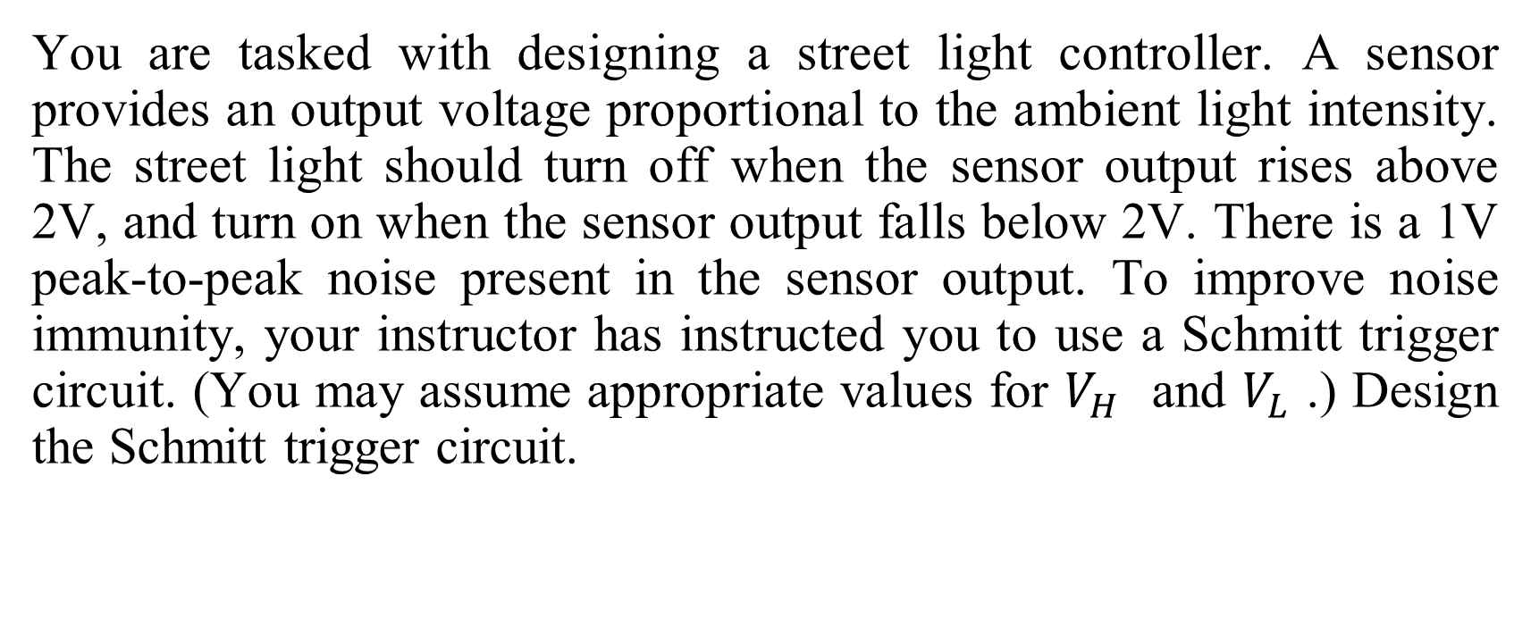
Exercise:

